Slide 1
Source wavelet effects on the ISS internal multiple leading-order attenuation algorithm and its higher-order modification that accommodate issues that arise when treating internal multiples as subevents
Hong Liang
M-OSRP Annual Meeting
May 2, 2013
Notes:
1
1

Slide 2
Motivation
Objective: predict the amplitude and phase of internal
multiples, without damaging primaries.
prerequisites: reference wave removal
source wavelet deconvolution
source and receiver deghosting
free surface multiple removal
enhance the capability of the algorithm:
from attenuation to elimination
heighten the inclusiveness of the algorithm

Slide 3
Motivation
Objective: predict the amplitude and phase of internal
multiples, without damaging primaries.
prerequisites: reference wave removal
source wavelet deconvolution
source and receiver deghosting
free surface multiple removal
enhance the capability of the algorithm:
from attenuation to elimination
heighten the inclusiveness of the algorithm

Slide 4
Motivation
Objective: predict the amplitude and phase of internal
multiples, without damaging primaries.
prerequisites: reference wave removal
source wavelet deconvolution
source and receiver deghosting
free surface multiple removal
enhance the capability of the algorithm:
from attenuation to elimination
heighten the inclusiveness of the algorithm

Slide 5
Outline
A brief review of the ISS internal multiple leading-order
attenuation algorithm and its higher-order modification
Source wavelet effects on the leading-order attenuator and
its higher-order modification
Using exact source wavelet: 1D example and 1.5D example
Using estimated source wavelet
Summary

Slide 6
The ISS leading-order attenuation algorithm
ISS internal multiple attenuation method:
does not require a priori information about the subsurface
predict exact time and approximate amplitude
predict internal multiples at all depths at once
prerequisites: source wavelet deconvolved, reference wave
removed, deghosted and free surface multiple removed

Slide 7
The ISS leading-order attenuator
For a 1D earth and a normal incident plane wave
:constant velocity migration of incident spike plane-wave data
ensures
and
: Green’s function in the reference medium
: perturbation operator
: migrated data-like first-order approximation to

Slide 8
The ISS leading-order attenuator
Data
Data
Data
primary
+
multiple
primary
+
multiple
primary
+
multiple

Slide 9
Subevent construction of an internal multiple
-
+
=
primary
primary
primary

Slide 10
Modification of the leading-order attenuator
When both primaries and internal multiples in the data themselves act as subevents, the leading-order attenuator produces not only first-order internal multiples, but also higher-order internal multiples and, at times, creates spurious events.
The ISS anticipates the issues due to spurious events, and higher-order terms in the series can provide the resolution.

Slide 11
An IM subevent in the second integral
primary
internal multiple
primary
-
+
=
Number of reflectors , and
spurious event
negative of spurious event

Slide 12
An IM subevent in one of the outer integral (1)
primary
primary
internal multiple
-
+
=
Number of reflectors

Slide 13
An IM subevent in one of the outer integral (2)
primary
primary
internal multiple
-
+
=
Number of reflectors

Slide 14
An IM subevent in one of the outer integral (3)
primary
primary
internal multiple
-
+
=
Number of reflectors , and
spurious event
negative of spurious event

Slide 15
Modification of the leading-order attenuator
Adding the further terms to the current leading-order
attenuator provides a modified ISS internal multiple
algorithm. The modification retains the strength of the
original algorithm while accommodating both primaries
and internal multiples in the input data.
Original | Modification

Slide 16
Prediction with source wavelet deconvolution

Slide 17
Prediction with source wavelet deconvolution

Slide 18
Outline
A review of the ISS internal multiple leading-order
attenuation algorithm and its higher-order modification
Source wavelet effects on the leading-order attenuator and
its higher-order modification
Using exact source wavelet: 1D example and 1.5D example
Using estimated source wavelet
Summary

Slide 19
Model for 1D synthetic data generation

Slide 20
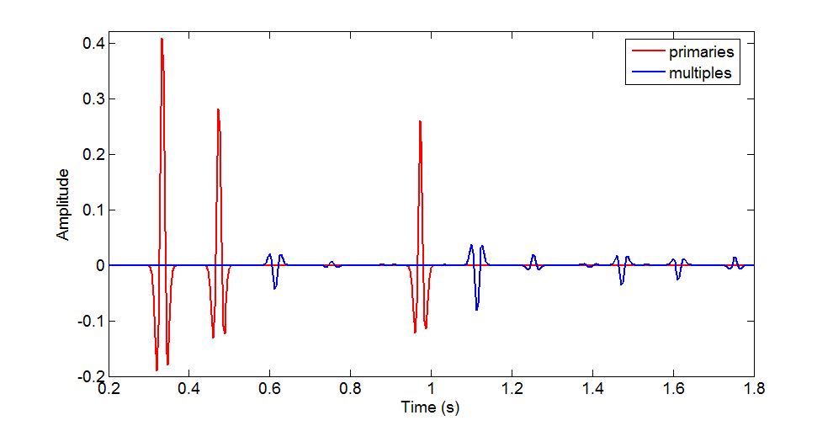
Input trace
red: primaries
blue: internal multiples

Slide 21
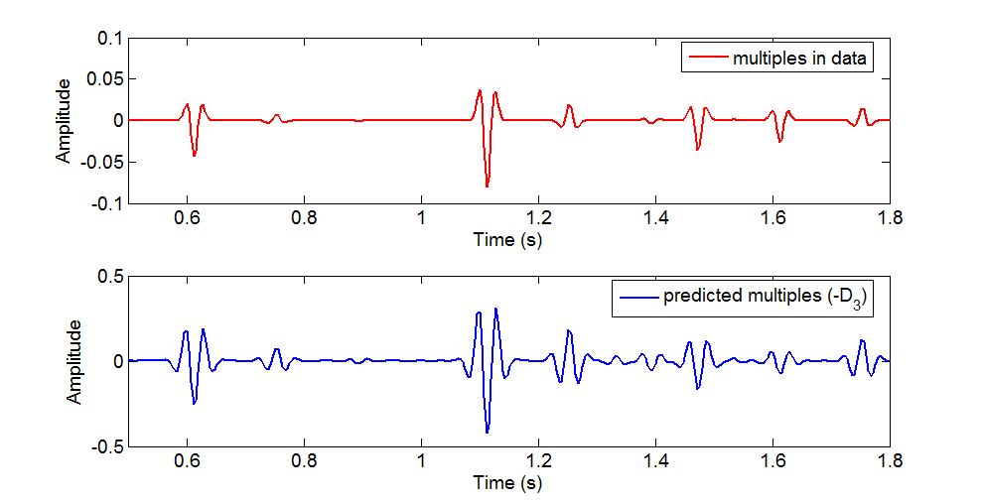
Actual multiples .vs. Prediction
red: actual internal multiples
blue: predicted internal multiple without
source wavelet deconvolution

Slide 22
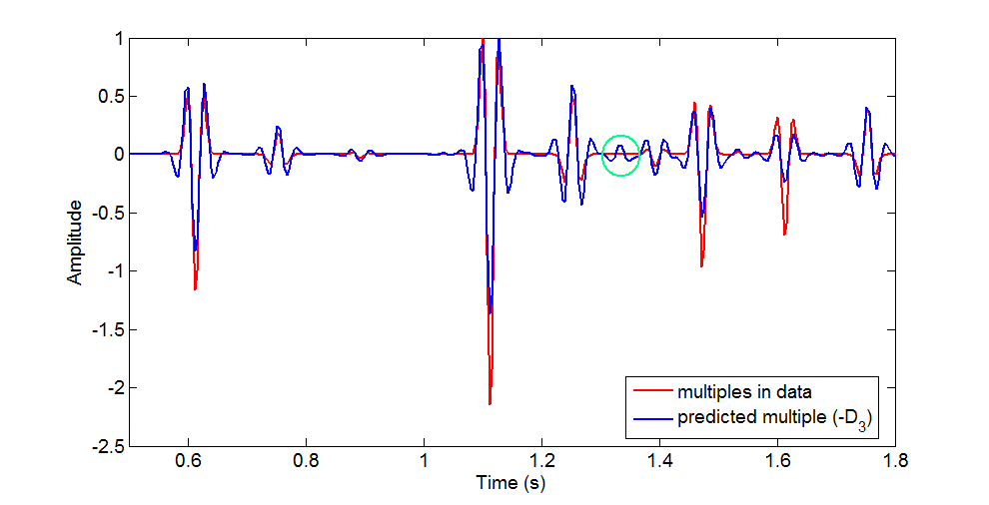
Actual multiples .vs. Prediction (normalized)
red: actual internal multiples
blue: predicted internal multiple without
source wavelet deconvolution

Slide 23
Prediction with source wavelet deconvolution

Slide 24
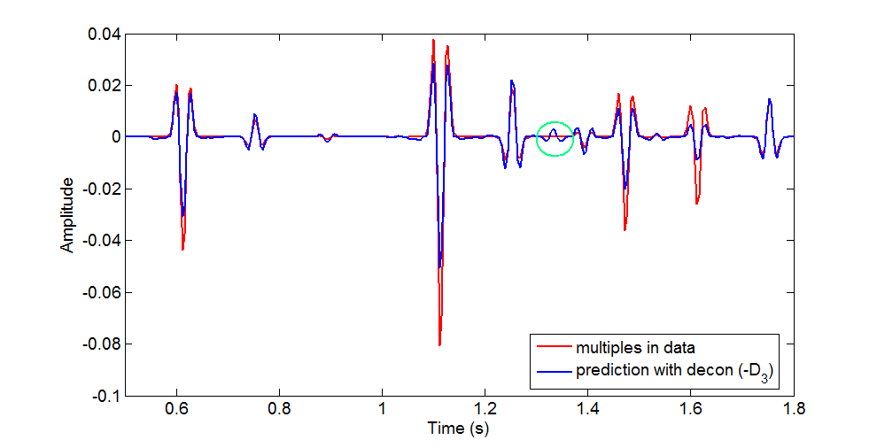
Actual multiples .vs. Prediction with decon
red: actual internal multiples
blue: predicted internal multiple with
source wavelet deconvolution

Slide 25
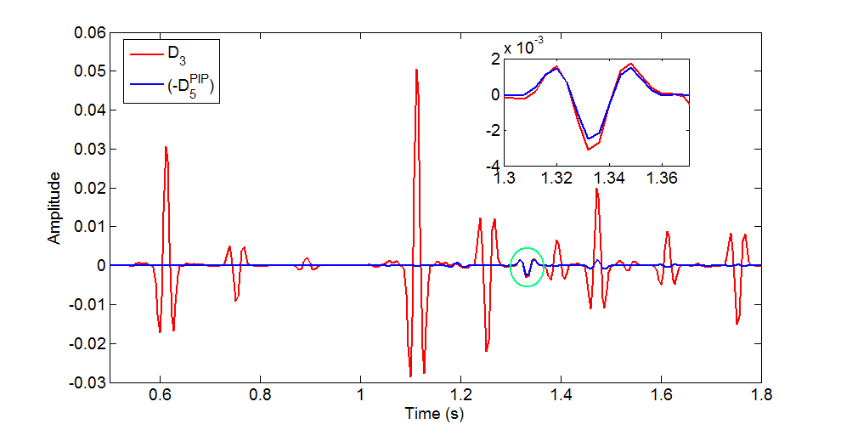
Spurious event .vs. Prediction with decon
red in circle: actual spurious event
blue in circle: predicted spurious event with
source wavelet deconvolution

Slide 26
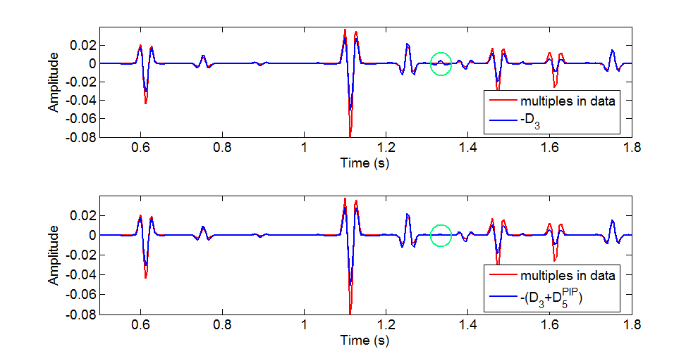
Actual multiples .vs. Prediction with decon
top and bottom red: actual internal multiples
top blue: (with deconvolution)
bottom blue: (with deconvolution)

Slide 27
Outline
A review of the ISS internal multiple leading-order
attenuator and its modification
Source wavelet effects on the leading-order attenuator and
its higher-order modification
Using exact source wavelet: 1D example and 1.5D example
Using estimated source wavelet
Summary

Slide 28
Model for 1.5D data modeling

Slide 29
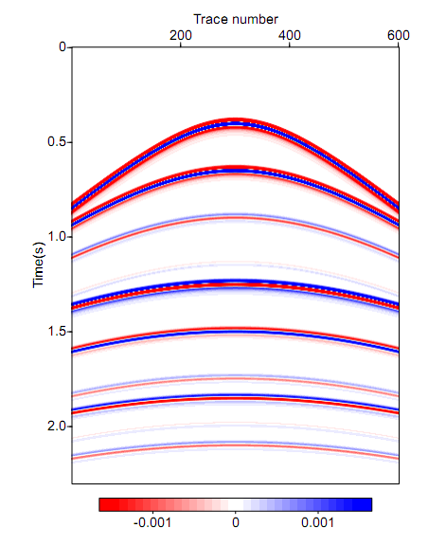
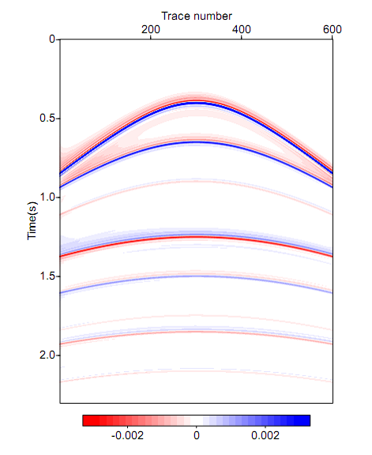
Data
primary
Data
Data after deconvolution

Slide 30
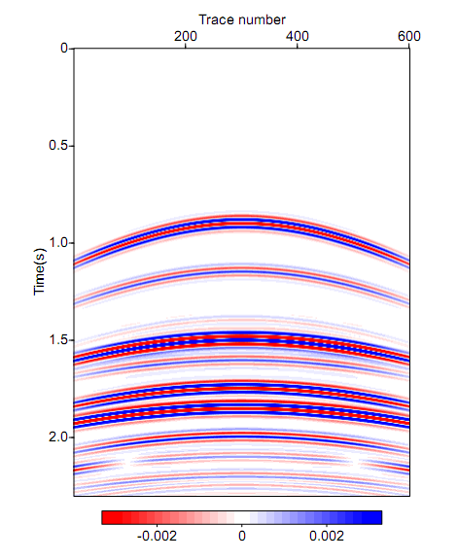
Multiple prediction without deconvolution
primary
Data
Multiple prediction without deconvolution

Slide 31
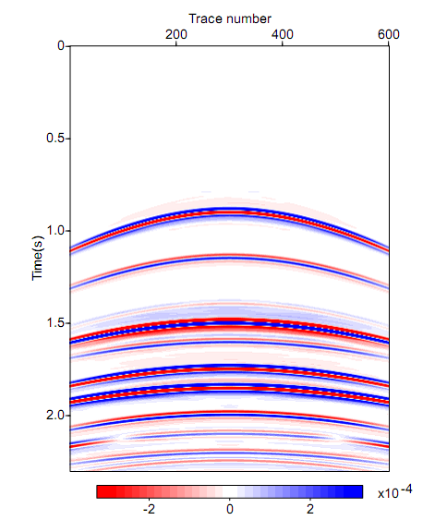
Multiple prediction with deconvolution
primary
Data
Multiple prediction with deconvolution

Slide 32
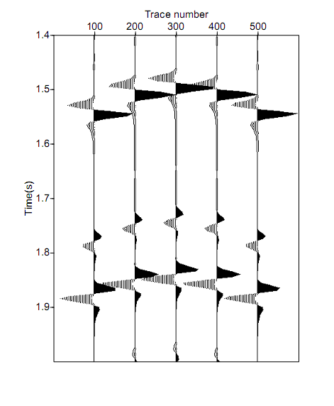
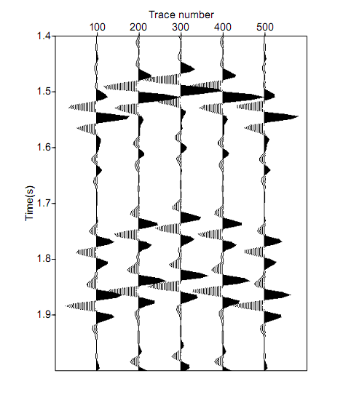
Wiggle comparison
I₃₁₂
I₃₁₂₁₂
I₃₂₃
Data
Multiple prediction without deconvolution

Slide 33
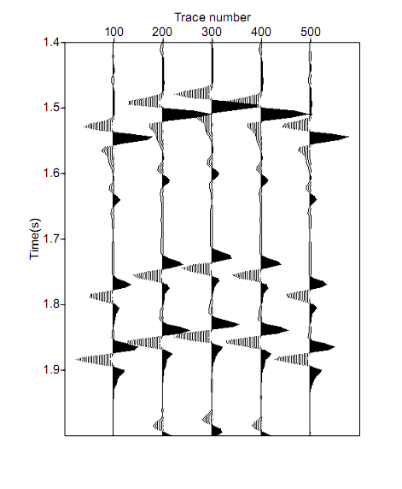
Wiggle comparison
I₃₁₂
I₃₁₂₁₂
I₃₂₃
Data
Multiple prediction with deconvolution

Slide 34
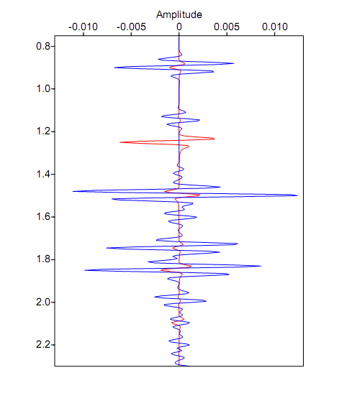
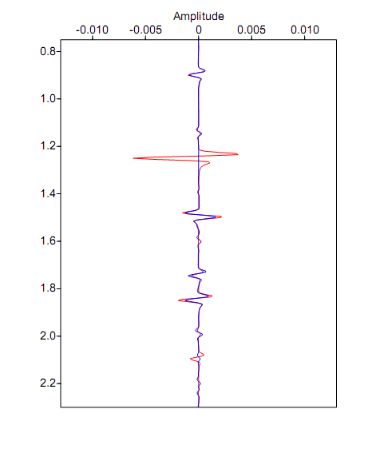
Zero-offset traces
I₂₁₂
I₂₁₂
I₂₁₂₁₂
P₃
I₂₁₂₁₂
I₃₁₂
I₃₁₂
spurious event
spurious event
I₃₁₂₁₂
I₃₁₂₁₂
I₃₂₃
I₃₂₃
red: input data
blue: multiple prediction without
source wavelet deconvolution
red: input data
blue: multiple prediction with
source wavelet deconvolution

Slide 35
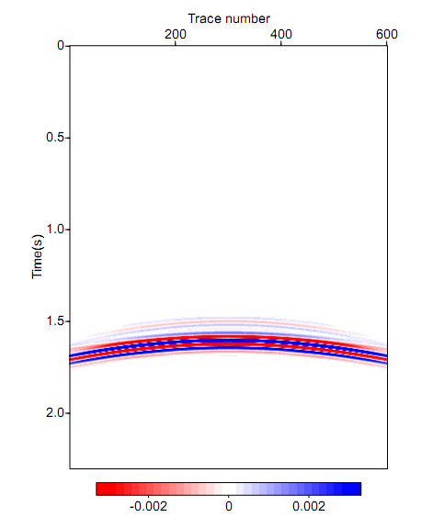
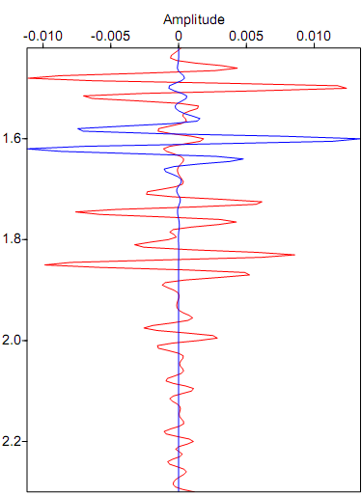
Spurious event prediction without deconvolution
spurious event
Multiple prediction without deconvolution (D₃)
Spurious event prediction without deconvolution (-D₅^{PIP})

Slide 36
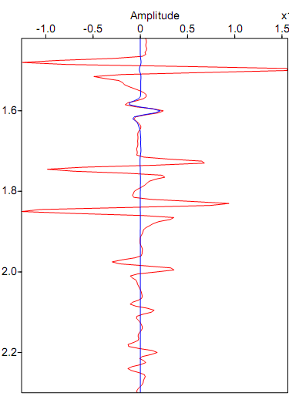
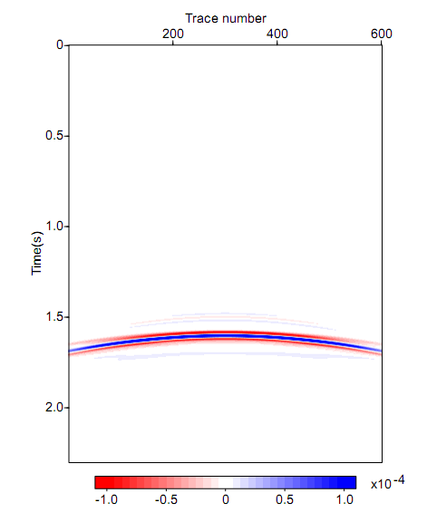
Spurious event prediction with deconvolution
spurious event
Multiple prediction with deconvolution (D₃)
Spurious event prediction with deconvolution (-D₅^{PIP})

Slide 37
Outline
A review of the ISS internal multiple leading-order
attenuation algorithm and its higher-order modification
Source wavelet effects on the leading-order attenuator and
its higher-order modification
Using exact source wavelet: 1D example and 1.5D example
Using estimated source wavelet
Summary

Slide 38
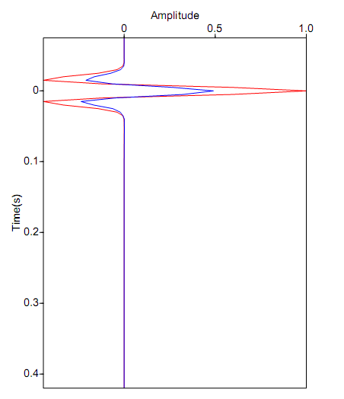
Example of inaccurate wavelet estimation
red: exact source wavelet
blue: estimated source wavelet

Slide 39
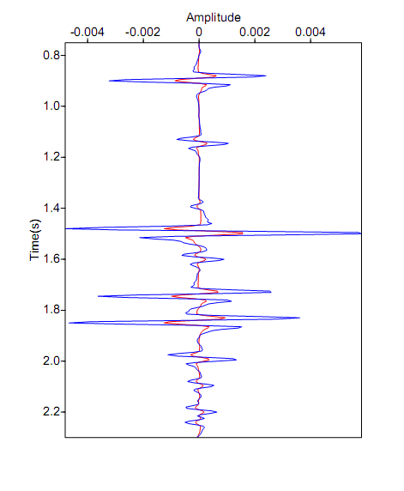
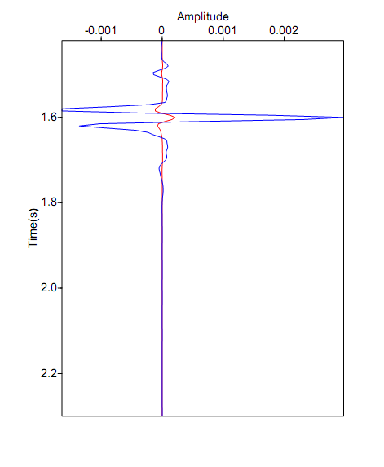
Prediction with inaccurate wavelet deconvolution
Multiple prediction (zero offset):
red: exact source wavelet
blue: estimated source wavelet
Spurious event prediction (zero offset):
red: exact source wavelet
blue: estimated source wavelet

Slide 40
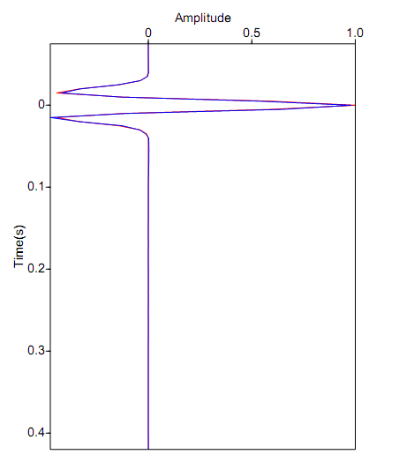
Wavelet estimation based on Green’s theorem
red: exact source wavelet
blue: estimated source wavelet

Slide 41
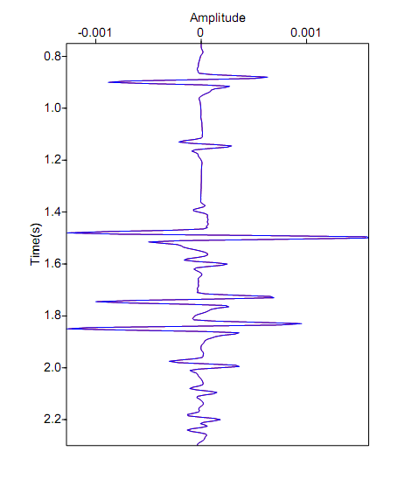
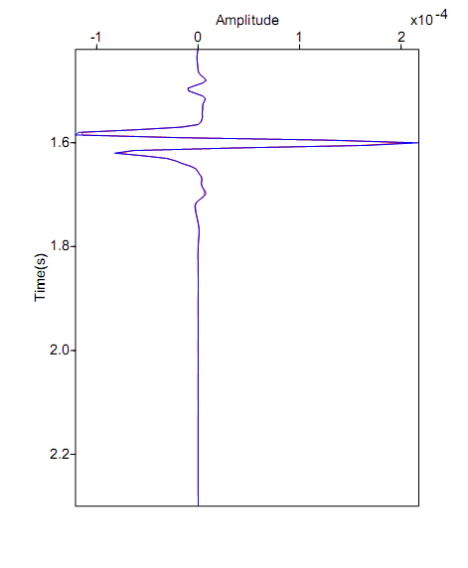
Prediction with accurate wavelet deconvolution
Multiple prediction (zero offset):
red: exact source wavelet
blue: estimated source wavelet
Spurious event prediction (zero offset):
red: exact source wavelet
blue: estimated source wavelet

Slide 42
Outline
A review of the ISS internal multiple leading-order
attenuation algorithm and its higher-order modification
Source wavelet effects on the leading-order attenuator and
its higher-order modification
Using exact source wavelet: 1D example and 1.5D example
Using estimated source wavelet
Summary

Slide 43
Prediction with source wavelet deconvolution

Slide 44
Summary
Source wavelet can affect the amplitude and shape of
internal multiple and spurious event prediction.
By including the source wavelet deconvolution, the
amplitude and shape of the prediction can be improved.
The accuracy of source wavelet is important, and it could be
estimated using Green’s theorem method.

Slide 45
References
Araújo, F. V., A. B. Weglein, P. M. Carvalho, and R. H. Stolt, 1994, Inverse scattering series for multiple attenuation: An example with surface and internal multiples: 64th Annual International Meeting, SEG, Expanded Abstracts, 1039–1041.
Ma, C., H. Liang, and A. B. Weglein, 2012, Modifying the leading order ISS attenuator of first-order internal multiples to accommodate primaries and internal multiples: fundamental concept and theory, development, and examples exemplied when three reectors generate the data: M-OSRP 2011 Annual meeting.
Liang, H., C. Ma, and A. B. Weglein, 2012, A further general modification of the leading-order ISS attenuator of first-order internal multiples to accommodate primaries and internal multiples when an arbitrary number of reectors generate the data: theory, development, and examples: M-OSRP 2011 Annual meeting.
Weglein, A. B., F. A. Gasparotto, P. M. Carvalho, and R. H. Stolt, 1997, An inverse scattering series method for attenuating multiples in seismic reflection data: Geophysics, 62, 1975–1989.
Weglein, A. B., and Secrest, B. G. 1990. Wavelet estimation for a multidimensional acoustic earth model. Geophysics, 55, 902-913.

Slide 46
Acknowledgement
Schlumberger / WesternGeco
Mission-Oriented Seismic Research Program (M-OSRP)

